Slide 1
Smart Access Control using Blockchain
Mentor: Dr. Rajendra Prasath

Slide 2
Team Members
Adwait Thattey (S20170010004)
Siddhant Jain (S20170010151)
Mahammad Adam Bagwan (S20170010021)

Slide 3
Contents
Project Idea
Justifying Blockchain for ACS
BTP work overview
Workflow of our proposed solution
Components
Users
Policy Models
Contracts
Transactions in Hyperledger Fabric
References

Slide 4
Project Idea
Understanding the Scope of Blockchain in Access Control Systems & Building an ABAC System for IOT Data.
Key Questions 1. Is Blockchain suitable for an ABAC Access Control Systems?
2. Why IOT Data?
3. Permission-less or Permissioned Blockchain with IOT ACS?
Notes:
Security in IoT devices is extremely important and many devices collect personal information.
We attempt to implement the ACS in an IoT network using Blockchain
Our idea is to build a permissioned blockchain system using Hyperledger Fabric that will act as a consent management system in the network.
The IoT devices continuously stream data to the storage. We enforce the access to the data of those devices using Policies and Smart contracts.

Slide 5
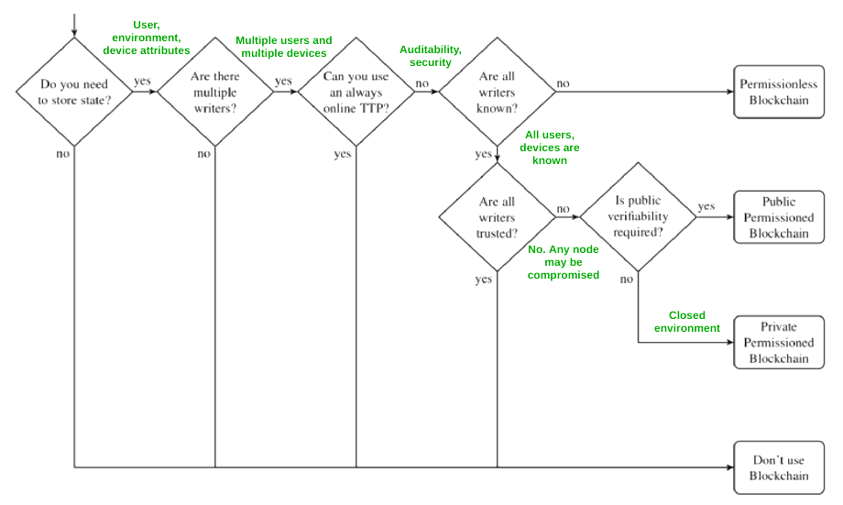

Slide 6
Access Control Systems
Key factors to consider for any production grade ACS
No Single Point of failure (Hardware Crashes)
Throughput
System Security
Auditability
*Security (no single weak system)
Notes:
Before answering if blockchain is suitable for ACS. Let’s see what key factors to consider for any acs
Latest ACS infrastructure handles it very well, There are good data replication and fault tolerance strategies
Throughput, since these devices which generate and process exponential amount of data every server must meet the throughput requirements
SYS security
Auditability → No provision other than logs which can be tampered → Blockchain records every Tx in immutable DB spread over every node in the network
If a single system is weak, then it doesn’t matter how secured other servers are. Blockchain inherently relies on Consensus
Decnetralized, Encryption and Public key crypto,

Slide 7
Why Hyperledger Fabric
Hyperledger Fabric
Faster consensus - less confirmation time - more throughput
Each member needs to be authorized to join a specific channel
No consistency issues (ordering service)
Network based on business use case
Cons of POW based Public Blockchain
Longer Transaction Confirmation time
Waste of resources. POW consumes a lot of resources and power
Consistency issues. Branching of Blockchain
Privacy issues

Slide 8
Work already done | Work for this evaluation | Work for next semester
Exploring Industrial use cases of Blockchain Challenges in Centrally Operated ACS High Level view of Blockchain components | Indepth Research on ACS using Blockchain. Implemented some Blockchain Components from scratch in Golang (components, POW) Learning Hyperledger Fabric Finalizing the workflow, models, and Smart Contract in the project Coding the models in Golang | Coding different types of smart contracts in the chain code for the fabric Scripts for enrolling admins, registering users Web UI Connecting with ipfs Integrating all components Analysis of performance with large number of Transactions using different consensus algorithms

Slide 9
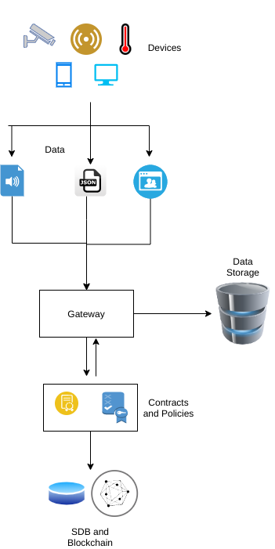
Workflow (Part 1)
The devices capture the data in various formats
They send the data to Gateway
The gateway checks for existing device and policies
If not, it fires device contracts to create url and device records
The contract commits to the Blockchain and the SDB
Data and the url is sent to the data storage

Slide 10
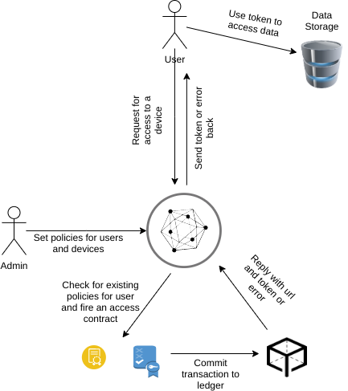
Workflow (Part 2)
The admin user sets policies and contracts for device and other users
User requests the system for access to the device data
Policies are retrieved and access contract is fired
If successful, token is generated and is sent back to the user
User uses the token to access the data

Slide 11
Policy Model
This model is designed with focus on IoT systems
User Attributes
User-id
Role
Group
Device Attributes
Device ID
Mac address
Environment Attributes
End time
Allowed IPs
Permission Attributes
Permission (allow or deny)
Policy Model = {UA, DA, EA, PA}

Slide 12
Policy Contract
Device Contract
Add URL
Take the device ID, Mac, IP
Write the URL of device into State database
Get URL
Given a Device ID, get URL
Update URL
If the device Mac, IP, ID changes
Update the signature and the url
Delete URL
If the device is removed
Remove the URL from state DB
Make Policy
Admin defines policy for users
Encrypt and sign data
Send the request to add policy
Check Policy
Check if policy is valid, all attributes are present etc
Check for any existing policy with similar attributes
Add Policy
Write the policy in the ledger
Add the policy in the state database
Update Policy
Update a policy instead of creating a new one
Delete Policy
Either the admin manually revokes a policy
Or time of policy has expired

Slide 13
Access Contract
Verify User
Check user’s key and verify identity
Fetch attributes
Get all the relevant attributes for user, device, environment
Check Access
Query the SDB for the relevant policies
Check if access should be granted or revoked
Generate Token
If the request is valid, query the SDB and get URL for the device
Generate the token for the request.
Token will contain attributes like Device_ID, hash of transaction, Policy ID, expire time, etc.

Slide 14
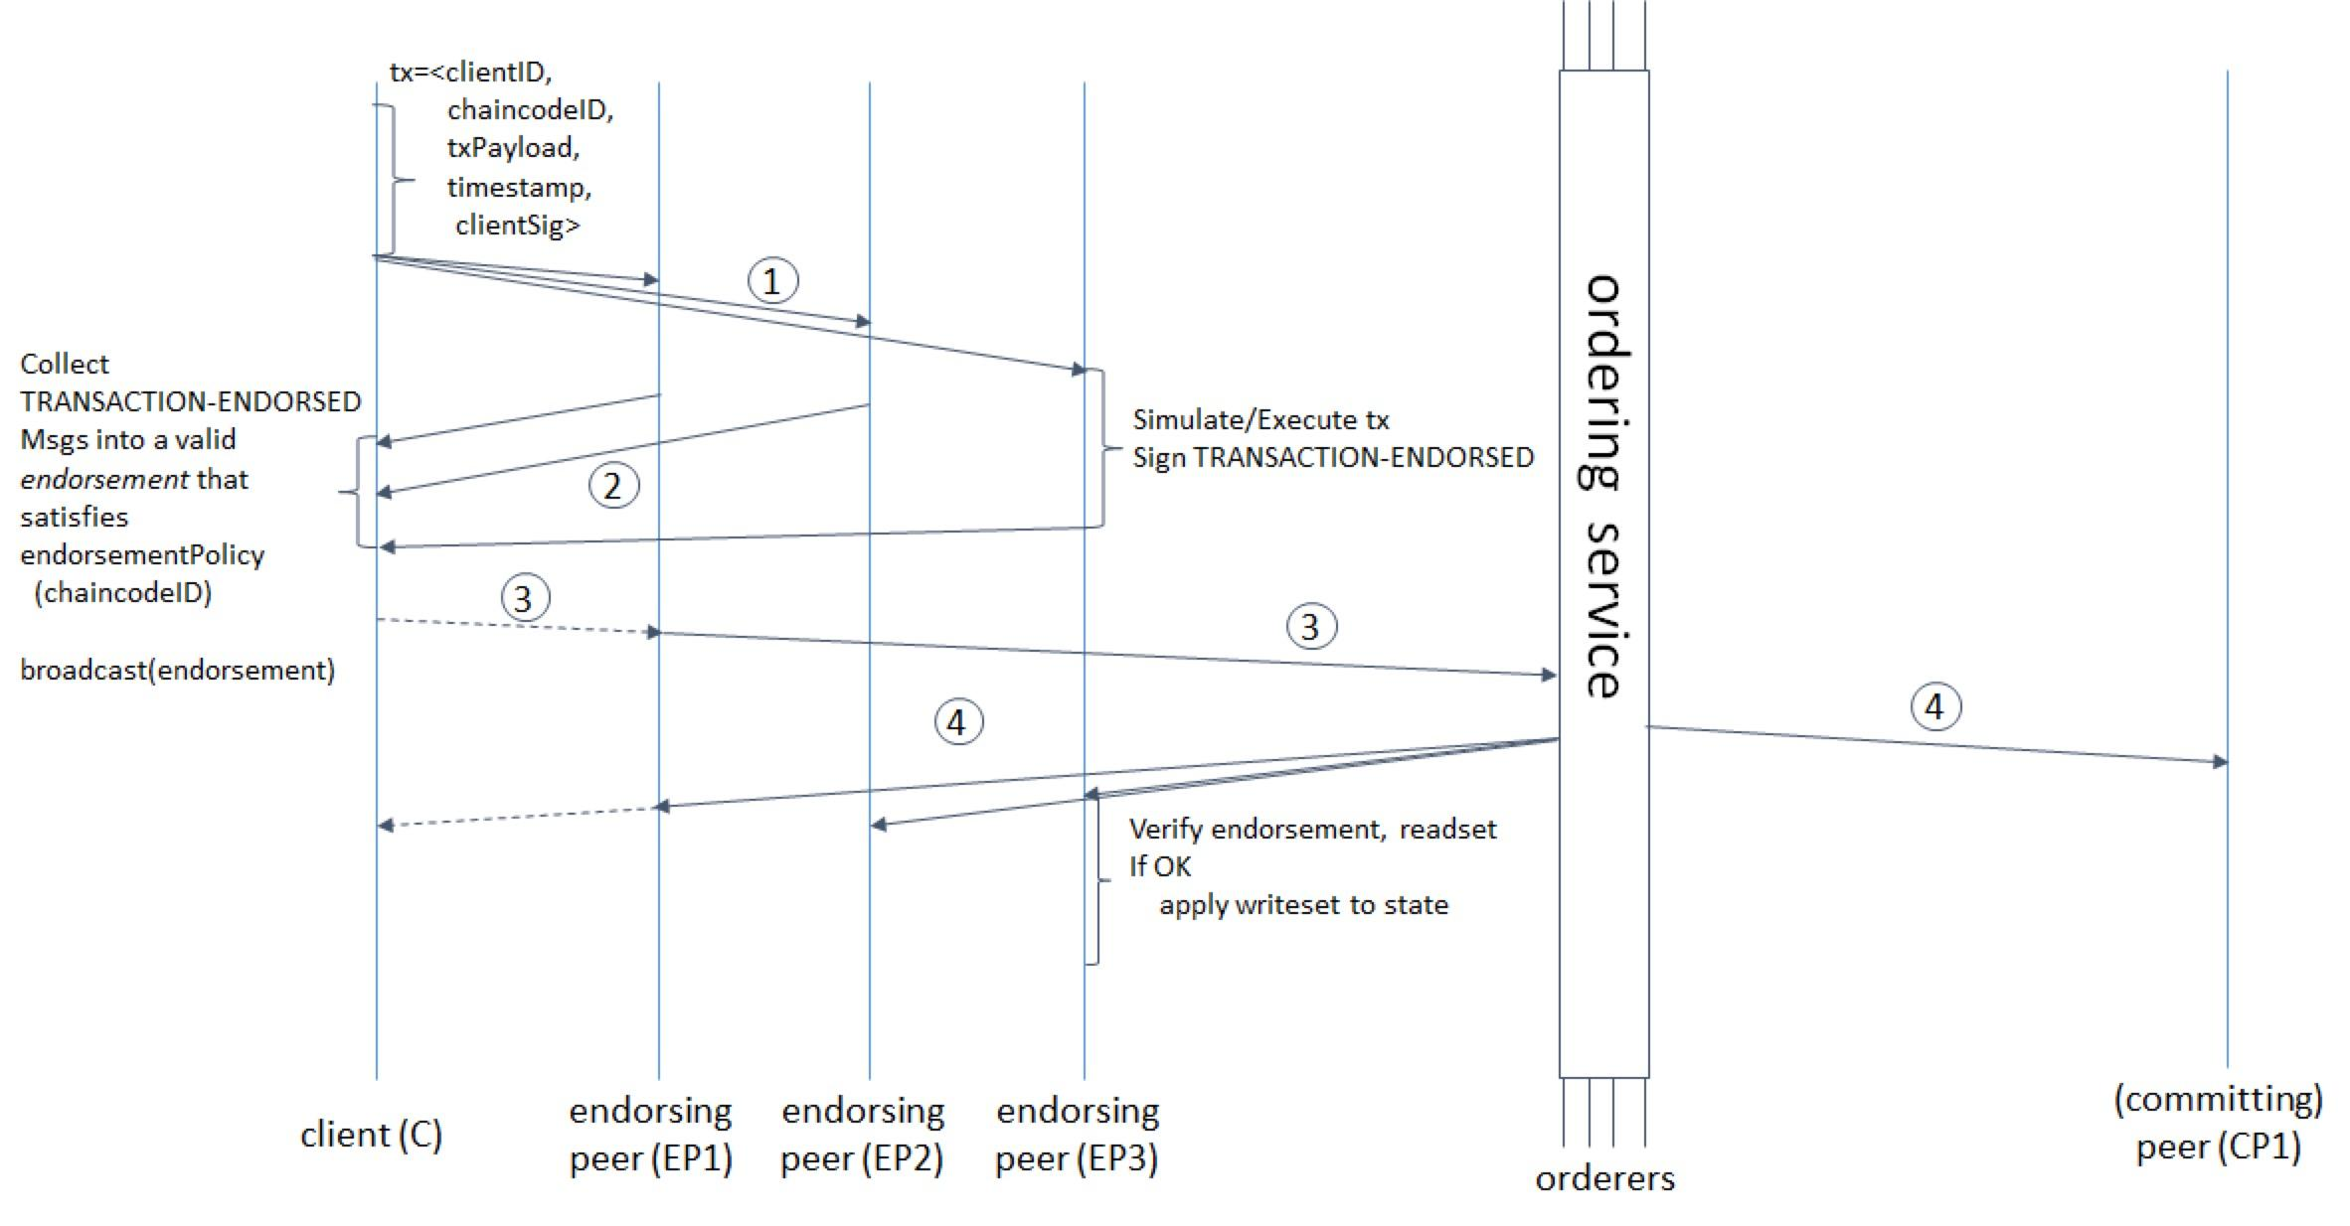
Transaction Flow in Hyperledger Fabric
Notes:
Client initiates a new transaction and sends it to Peer A and Peer B
Endorsement policy → states that both peers should sign the transaction
The transaction is basically about reading or uploading the ledger
Step2
Peers verify signature and execute the TX
Checks if Tx is well formed
It has not been submitted in the past
Signature is valid (using the MSP)
These endorsing peers then take tx proposal as input to chaincode function and executes it. The execution is against the current state db. And it generates a response value, a read set and a write set (representing an asset to create or update)
Step3
Response is accepted by client
App verifies endorsing peer’s signature and
Compares all responses to see if they are same
Again an optimisation here
If tx only wants to query the ledger, It is not processed furthur
If Tx is for updating the ledger, the client app determines if the specified endorsement policy Has been fulfilled
Step 4
Client broadcasts the TX proposal and responses to ordering service
What is an ordering service? It basically orders the TX forms block and sends to peers. It is the consensus part of Hyperledger fabric
It is needed so that all the other peers can recieve same ordered set of TX and thus produce deterministic updates (same updates in all nodes)
Consensus → RAFT, KAFKA, SOLO The difference between Consensus algos in Public and Private blockchain is; these algos provide higher Tx throughput
Step 5 Ordering service orders Tx and broadcasts to all peers
Step 6 Peers validate the Tx according to enrollment policy and check for double spending
Step 7 Commit Tx in the ledger and event is emmitted to client stating the success or faliure due to invalidation

Slide 15
References
D. Di Francesco Maesa, P. Mori, and L. Ricci, “A blockchain based approach for the definition of auditable Access Control systems,” Computers & Security, vol. 84, pp. 93–119, Jul. 2019, doi: 10.1016/j.cose.2019.03.016.
C. Lin, D. He, X. Huang, K.-K. R. Choo, and A. V. Vasilakos, “BSeIn: A blockchain-based secure mutual authentication with fine-grained access control system for industry 4.0,” Journal of Network and Computer Applications, vol. 116, pp. 42–52, Aug. 2018, doi: 10.1016/j.jnca.2018.05.005.
Mounnan, Oussama & Abou, Anas. (2019). Efficient Distributed Access Control Using Blockchain for Big Data in Clouds.
[S. Ding, J. Cao, C. Li, K. Fan, and H. Li, “A Novel Attribute-Based Access Control Scheme Using Blockchain for IoT,” IEEE Access, vol. 7, pp. 38431–38441, 2019, doi: 10.1109/access.2019.2905846.
T. Sultana, A. Ghaffar, M. Azeem, Z. Abubaker, M. U. Gurmani, and N. Javaid, “Data Sharing System Integrating Access Control Based on Smart Contracts for IoT,” in Advances on P2P, Parallel, Grid, Cloud and Internet Computing, Springer International Publishing, 2019, pp. 863–874. [Link]
Androulaki, E., Barger, A., Bortnikov, V., Cachin, C., Christidis, K., De Caro, A., Enyeart, D., Ferris, C., Laventman, G., Manevich, Y., Muralidharan, S., Murthy, C., Nguyen, B., Sethi, M., Singh, G., Smith, K., Sorniotti, A., Stathakopoulou, C., Vukolić, M., … Yellick, J. (2018, April 23). Hyperledger fabric. Proceedings of the Thirteenth EuroSys Conference. EuroSys ’18: Thirteenth EuroSys Conference 2018. https://doi.org/10.1145/3190508.3190538

